Slide 1
Lecture 26: Autoencoders Marios Mattheakis

Slide 2
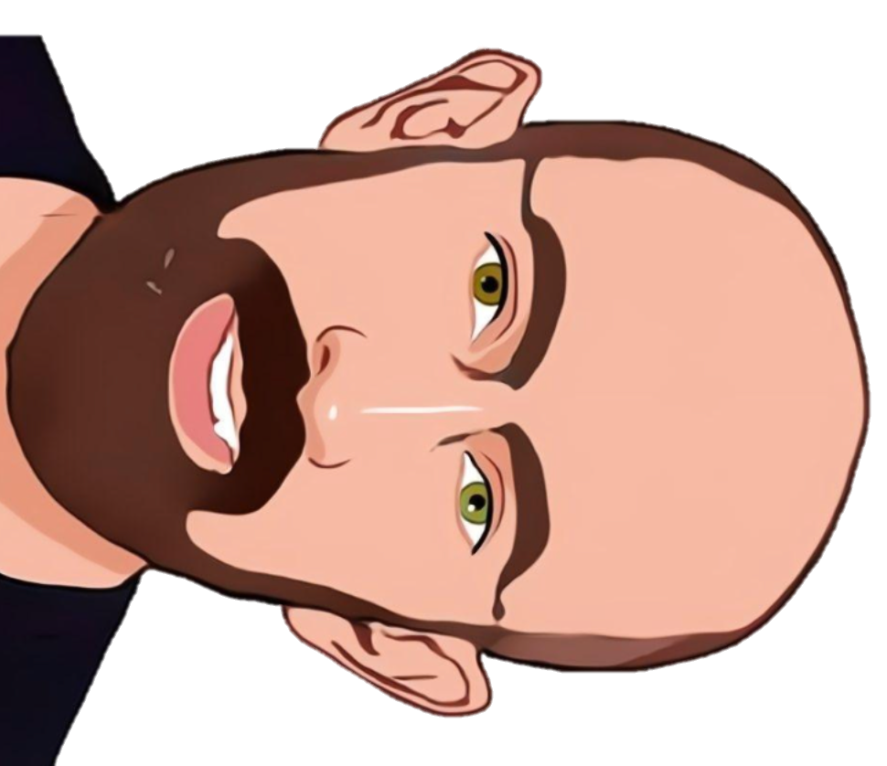
Pavlos game #4275
WHO IS MOST SIMILAR TO PAVLOS?
Option a
Option B
Option C

Slide 3

WHO IS MOST SIMILAR TO PAVLOS?
(
) =
COSINE SIMILARITY
0.987
(
) =
COSINE SIMILARITY
0.912
(
) =
COSINE SIMILARITY
0.826

Slide 4
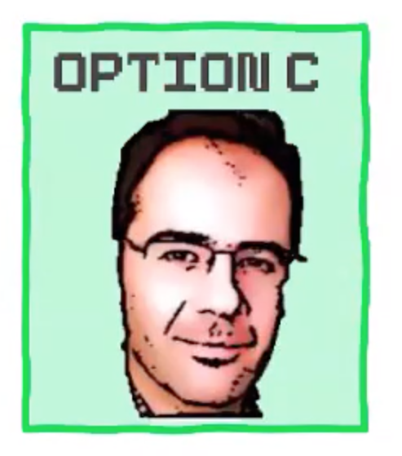
Winner !
The prize of the competition was to give a lecture for the CS109B
Doing research in the intersection of data science and applied physics developing deep neural network architectures for:
Solving differential equations
Eigenvalue quantum problems
Material science (crystal structures)
Hamiltonian Networks
Inverse problems
…
Research Associate at IACS
https://scholar.harvard.edu/marios_matthaiakis/home

Slide 5
Lecture 26: Autoencoders Marios Mattheakis

Slide 6
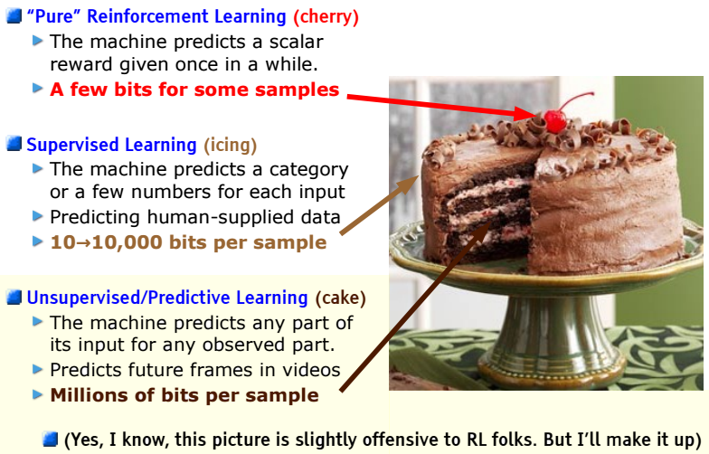
Original Yann LeCun cake analogy slide presented at NeurIPS 2016. The highlighted area has now been updated.
Notes:
Most of the data outside are unlabeled data. That’s the cake, unsupervised learning
Unsupervised k-means clustering. Searching for structures in the unlabeled data without knowing if this is correct or not (no ground truth).
Language models
Representation learning

Slide 7
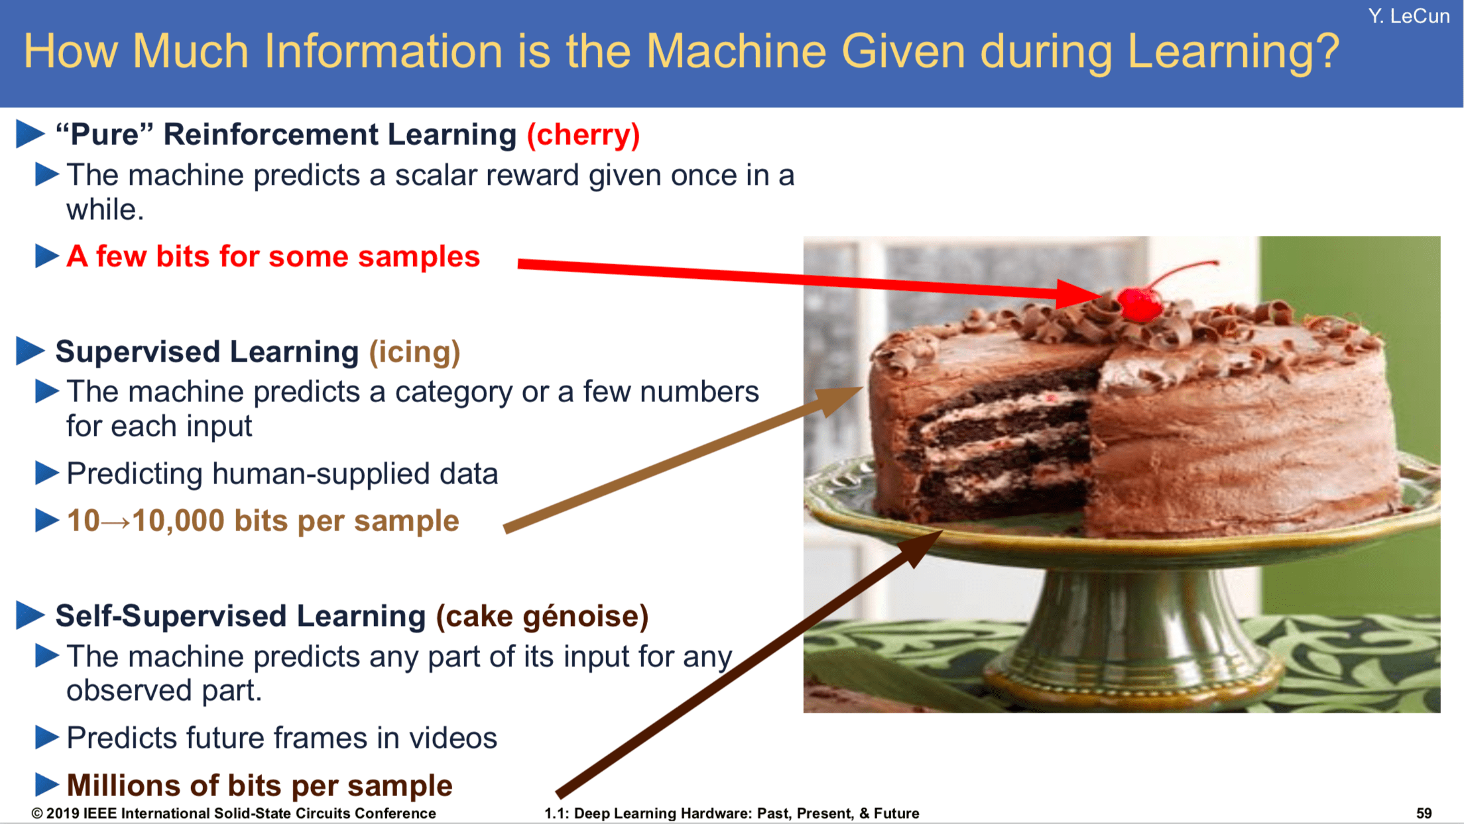
LeCun updated his cake recipe at the 2019 International Solid-State Circuits Conference (ISSCC) in San Francisco, replacing “unsupervised learning” with “self-supervised learning,” a variant of unsupervised learning where the data provides the supervision.
Notes:
The question is how can we write a loss function to have backpropagation and thus, to train a network
Autoencoders are Self-supervised networks. This is what we are going to see today, the whole cake

Slide 8
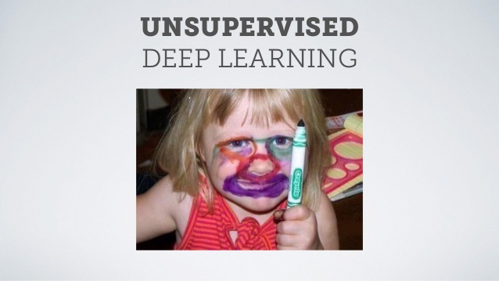
Unsupervised or self-supervised learning
Self-supervised learning can be challenging

Slide 9
Autoencoders Part A

Slide 10
Outline
What are autoencoders?
Brief history of encoding/decoding.
Inside autoencoders.
Convolutional autoencoders.
Regularization of autoencoders.
Applications
Denoising
Blending

Slide 11
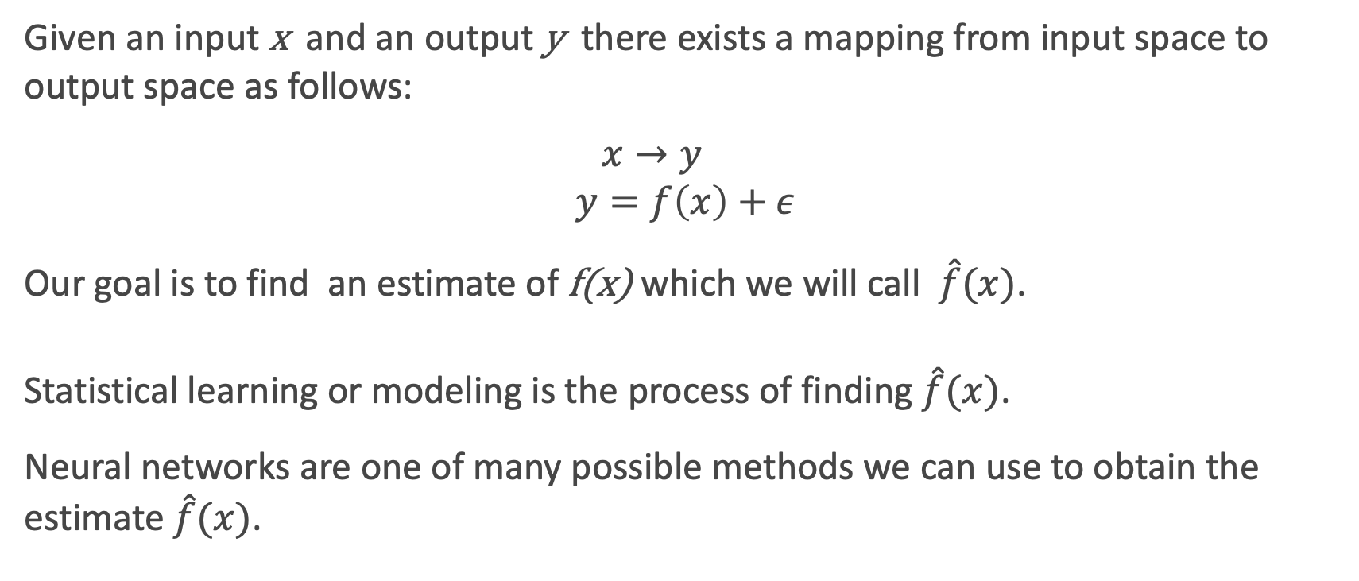
Neural Networks as universal function approximators
Given an input x and an output y there exists a mapping from input space to output space as follows:
$$x→y \\ y=f\left(x\right)+ε$$
Our goal is to find an estimate of f(x) which we will call $\hat{f}(x)$.
Statistical learning or modeling is the process of finding $\hat{f}(x)$.
Neural networks are one of many possible methods we can use to obtain the estimate $\hat{f}(x)$.

Slide 12

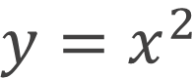
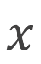
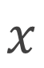
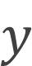


Linear Regression
$$x$$
$$\hat{y}$$
Linear
Regression
Fit quadratic function
Do your best !
$$y$$
$$y=x^{2}$$
$$y$$
$$x$$
$$x$$
But we know that this is not the best
Notes:
Repr Learning connects a lot of topics

Slide 13




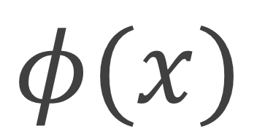
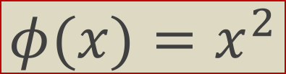
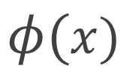
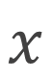
Representational Learning
Representation Matters
$$x$$
$$φ(x)$$
$$\hat{y}$$
Learn
Representation
Linear
Regression
$$y$$
$$y$$
$$φ(x)=x^{2}$$
$$x$$
$$φ(x)$$
Notes:
Passing through some function fi(x) and then we perform a linear regression.

Slide 14
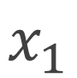

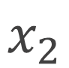


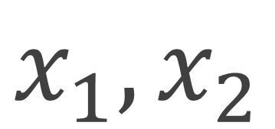
Representational Learning
Representation Matters
$$x_{1},x_{2}$$
$$\hat{y}$$
Logistic
Regression
Fit polynomial function
Do your best !
$$x_{2}$$
$$x_{2}$$
$$x_{1}$$
$$x_{1}$$

Slide 15

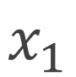
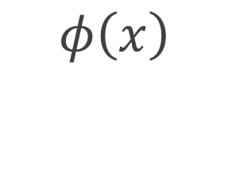

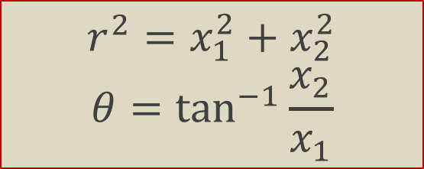
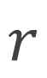
Representational Learning
Representation Matters
$$x$$
$$φ(x)$$
$$\hat{y}$$
Learn
Representation
Linear
Regression
$$x_{2}$$
$$φ\left(x\right)$$
$$θ$$
$$r^{2}=x_{1}^{2}+x_{2}^{2}$$
$$θ=\tan^{−1}{\frac{x_{2}}{x_{1}}}$$
$$x_{1}$$
$$r$$

Slide 16

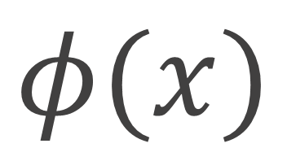

Representational Learning
Representation Matters
$$x$$
$$φ(x)$$
$$\hat{y}$$
Learn
Representation
Task

Slide 17
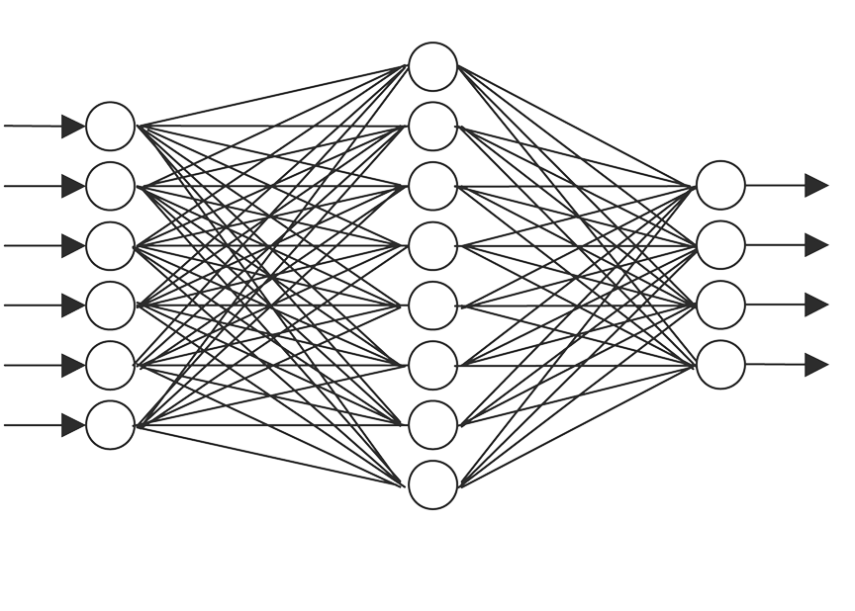
Representational Learning
Representation Matters
$$x$$
$$φ(x)$$
$$\hat{y}$$
Learn
Representation
Task
Notes:
The first NN will learn the representation and the second NN will do the task

Slide 18
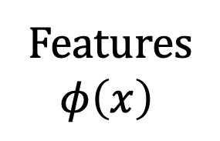
Representational Learning: Supervised Learning
We train the two networks by minimizing the loss function (cross entropy loss)
X
Y
Features
$$φ\left(x\right)$$
{Cat,Dog}
Feature Discovery Network
Classification Network

Slide 19
Representational Learning: Self-supervised Learning
No labels
Specialized features for Task
We train the two networks by minimizing the loss function (cross entropy loss)
X
Y
Features
$$φ\left(x\right)$$
{Cat,Dog}
Feature Discovery Network
Classification Network
Notes:
All the networks are updated at the same time, but for the particular task (I don; like that), also we if I don’t have labels like (cats, dogs)

Slide 20
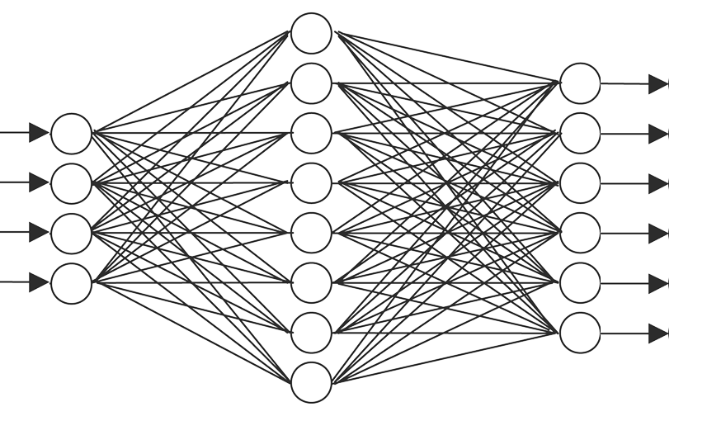
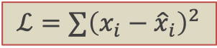
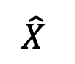
Representational Learning: Self-supervised Learning
We train the two networks by minimizing the reconstruction loss function:
$$ℒ=∑{\left(x_{i}−{\hat{x}}_{i}\right)}^{2}$$
X
$$\hat{X}$$
Features
$$φ\left(x\right)$$
Feature Discovery Network
Second Network
Notes:
Encode the cat in the fi(x) and decode it back

Slide 21

Representational Learning: Self-supervised Learning
We train the two networks by minimizing the reconstruction loss function:
$$ℒ=∑{\left(x_{i}−{\hat{x}}_{i}\right)}^{2}$$
X
$$\hat{X}$$
Latent Space
$$Z$$
ENCODER
DECODER

Slide 22
Representational Learning: Self-supervised Learning
We train the two networks by minimizing the reconstruction loss function:
$$ℒ=∑{\left(x_{i}−{\hat{x}}_{i}\right)}^{2}$$
AUTOENCODER
X
$$\hat{X}$$
Latent Space
$$Z$$
ENCODER
DECODER
This is an autoencoder. It gets that name because it automatically finds the best way to encode the input so that the decoded version is as close as possible to the input.
Notes:
Beauty: The features are not specialized in the task.
I don’t want to classify cats, I want to understand cats
Want to learn the essence. Contexual learning
Encode the essence in the latent space (an abstract low dimensional space) and then decode back

Slide 23
Brief history of encoding/decoding
Is this a new idea?
MP3 can compress music files by a factor of 10 enabling digital storage and transmission large volumes of audio.
JPG compresses images by a factor of 10-20 and enables storage and transmission of image data.
These technologies led the way to the image-rich web and abundance of music that we enjoy today.
Notes:
Is this a new idea ?? No, very old idea.

Slide 24
Brief history of encoding/decoding (cont)
MP3 and JPG take an input and encode it into a compressed form.
Then they decode or decompress the compressed version back to the original version.
Do we get the same quality after the decoding?

Slide 25
Lossless and Lossy Encoding
Loss: The difference between the original and post-decompression object
Example: Imagine, I want to make a presentation for upcoming Pavlos’ group meeting, so I am asking Pavlos on slack about the topic of the talk
Pavlos, which topic should I present in the next group meeting?
Pavlos is biking (his regular 100Km distance) but also wants to reply at the same time
IMO RL
Immediately, I read (knowing that Pavlos likes representation learning)
In My Opinion Representation Learning
A 33 characters message is compressed to 5 characters (that’s a good compression)

Slide 26
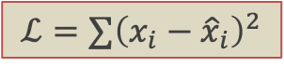
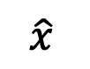
Lossless and Lossy Encoding (cont)
Question: Is this an example of lossy or lossless compression?
After a week of hard preparation, I got an excellent presentation on
Representation Learning
but Pavlos and the other members of the Lab were expecting a talk on
Reinforcement Learning
A way to test if a transformation is lossy or lossless is to measure the difference between the reconstructed and original data. In autoencoders this is the reconstruction loss function.
$$ℒ=∑{\left(x_{i}−{\hat{x}}_{i}\right)}^{2}$$
x
$$\hat{x}$$
Z
ENCODER
DECODER
Notes:
That was a very lossy week for me

Slide 27
MP3 and JPG Image Compression
original
MP3
JPG
256x256=262,000
37,000
26,000
Image taken from A. Glassner, Deep Learning, Vol. 2: From Basics to Practice

Slide 28
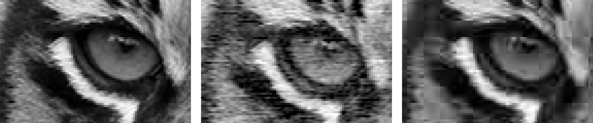
MP3 and JPG Image Compression(cont)
original
MP3
JPG
Image taken from A. Glassner, Deep Learning, Vol. 2: From Basics to Practice

Slide 29
What are autoencoders?
A particular kind of deep learning architecture.
Compress inputs into a form that can later be decompresses
Autoencoders are more general than MP3 and JPG
Able to find a general (abstract) representation of unlabeled data
They are usually used to …
reduce data dimensionality
find general representation and underlying relationships
Image denoising, infilling, coloring, blending
Anomaly detection
…
Notes:
Compare with PCA. It is a special case of AE

Slide 30
Why a self-supervised learning method?
We say that an autoencoder is an example of semi-supervised or self-supervised learning.
It sort-of is supervised learning because we give the system explicit goal data (the output should be the same as the input),
and it sort-of is not supervised learning because we don’t have any manually determined labels or targets on the inputs.

Slide 31

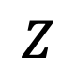
The simplest autoencoder
Encode with a simple fully connected network (FCN)
Image 100x100
Flatten Image 10,000
FCN with 20 neurons
20 numbers
$$Z$$
…
…
…
Parameters: 10K x 20 + 20

Slide 32
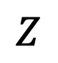
The simplest autoencoder
Encode and decode together after training
Image 100x100
Flatten Image 10,000
FCN with 20 neurons
FCN with 10,000 neurons
.reshape(100,100)
…
…
…
$$Z$$
10,000 numbers
…
…
Parameters: 10K x 20 + 20
Parameters: 10K x 20 + 10K

Slide 33
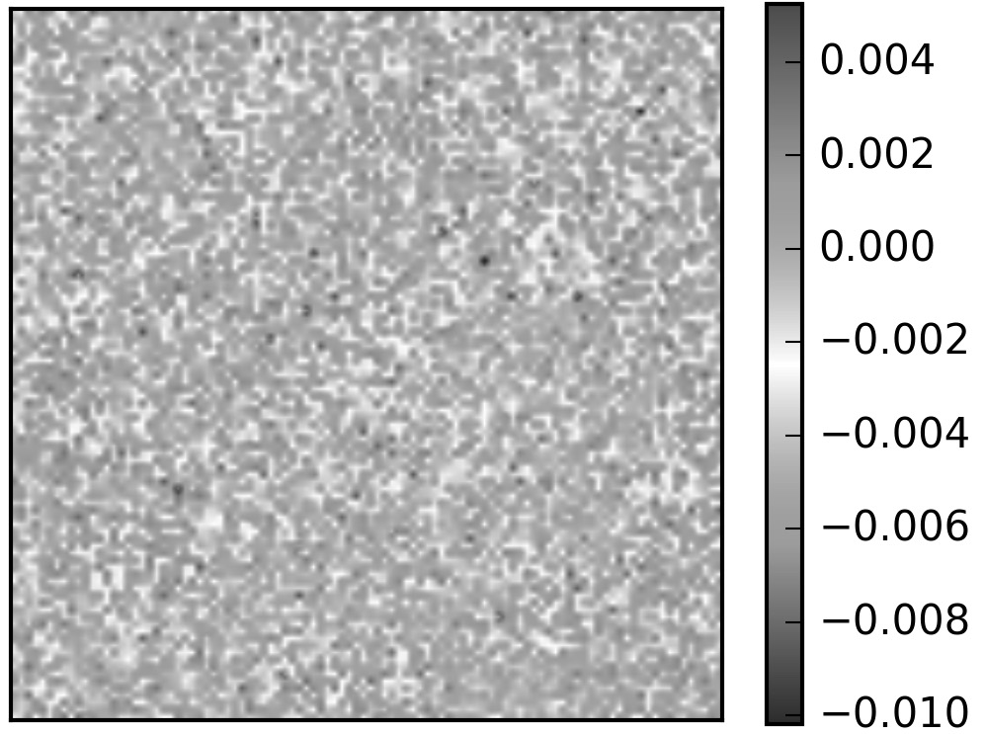
Autoencoders in action
Comparing the input and output pixel by pixel.
Input Image 100x100
Output Image 100x100
Residuals 100x100

Slide 34
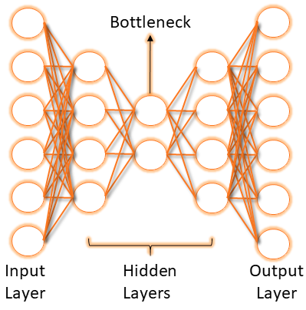
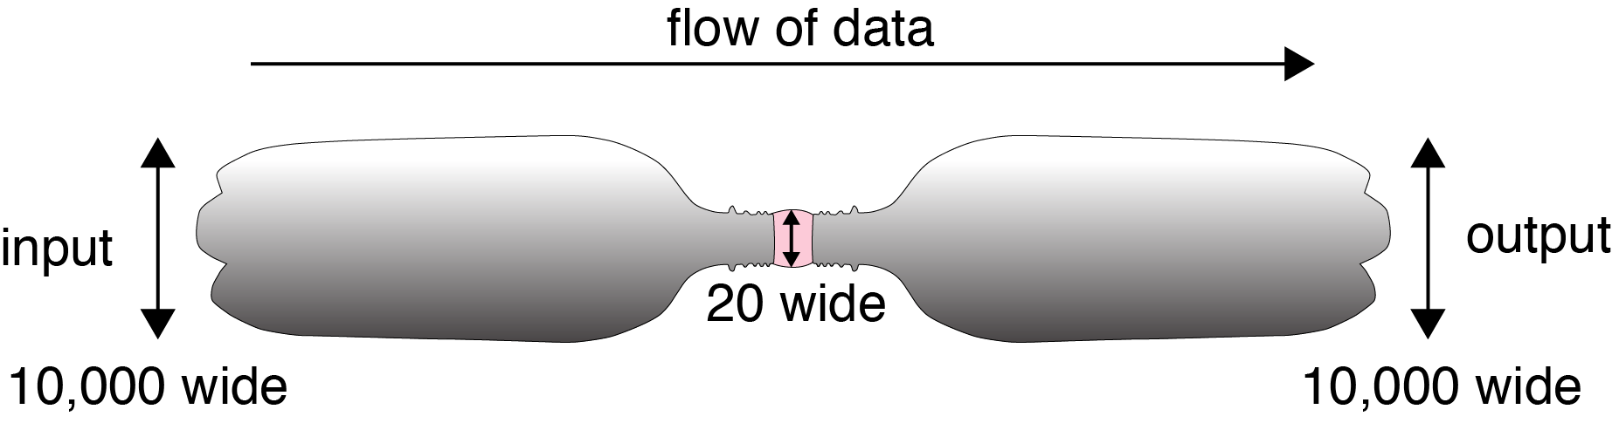
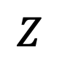
Bottleneck
We start with 10,000 elements
We have 20 in the middle
And 10,000 elements again at the end
$$Z$$
Notes:
Z: abstract, hidden, important, do not exist

Slide 35
Autoencoders in action (cont)
Passing “Pavlos” to the previously trained autoencoder returns:
20 neurons
10K neurons
How about if we input the “Eagle”?
20 neurons
10K neurons
Notes:
it memorizes, all the weights are turn off instead of the biases
How can we improve it ?

Slide 36
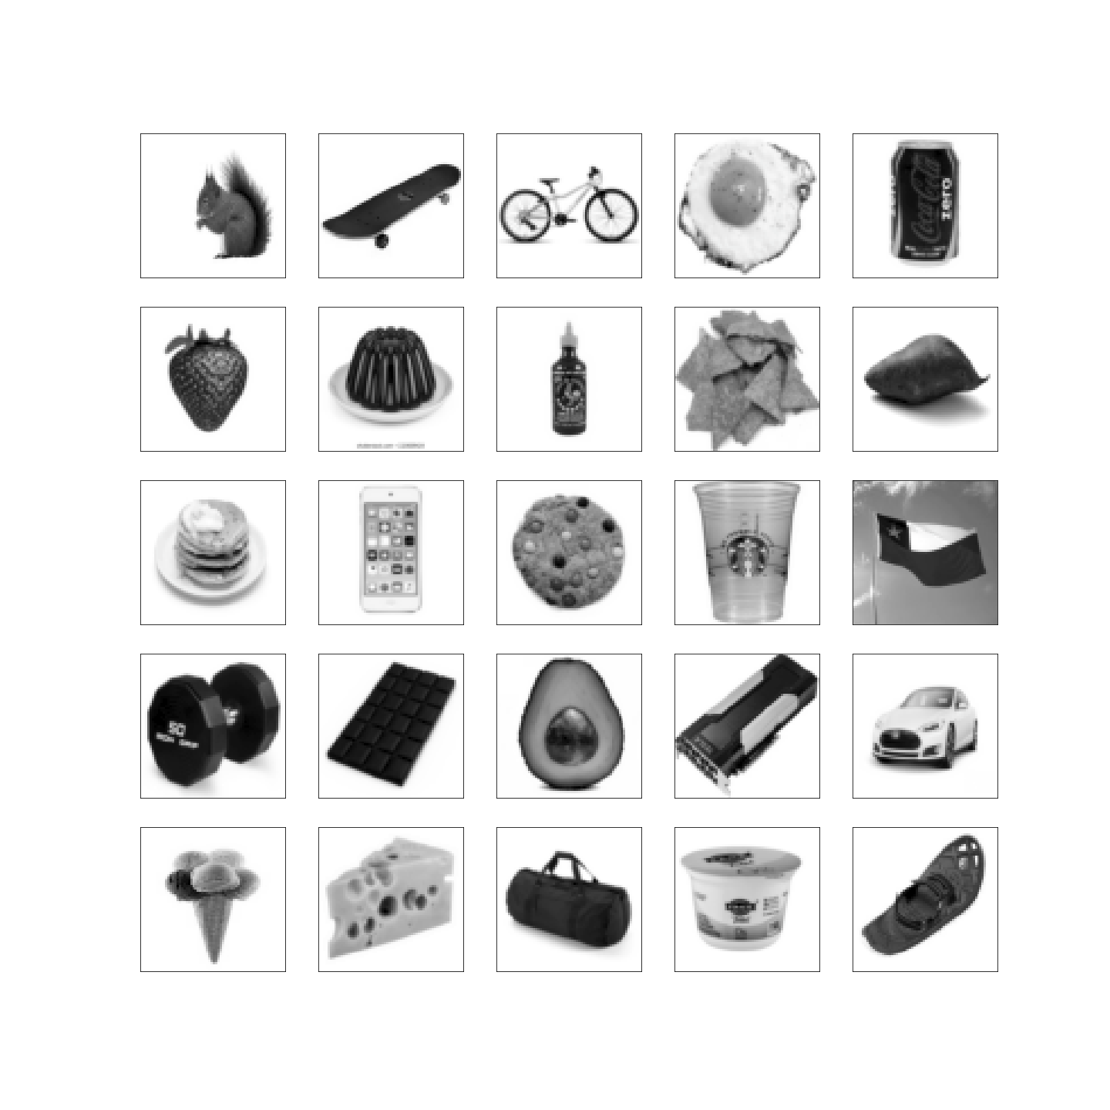
Autoencoders in action (cont)
We should train with a variety of images.

Slide 37
Autoencoders in action (cont)
After training with those images, let’s test how well it generalizes:
20 neurons
10K neurons
Network has never seen anything like this, so it is no surprise that could not reconstruct a face.

Slide 38
Autoencoders in action (cont)
We can use a better training set such as the Olivetti faces
20 neurons
10K neurons
Notes:
It generalizes in the domain of the training set
This dataset contains a set of face images taken between April 1992 and April 1994 at AT&T Laboratories Cambridge, 40 images

Slide 39
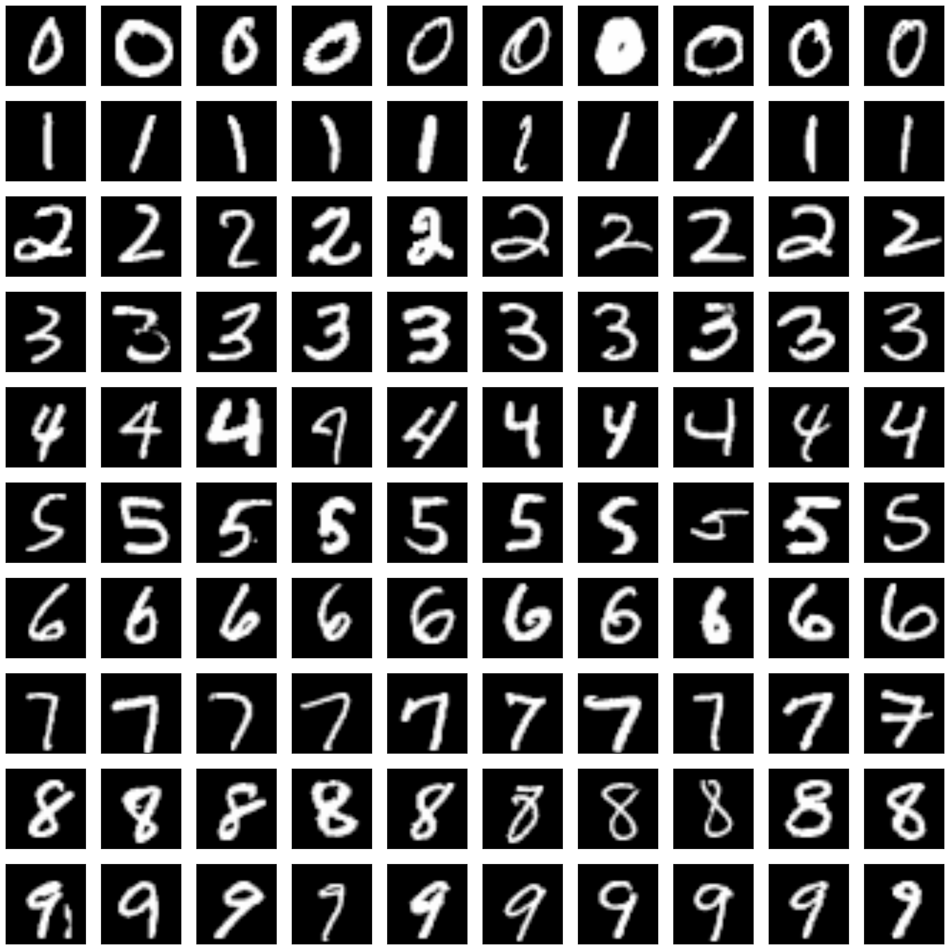
Train on a better dataset yields a better autoencoder
MNIST data: train a simple AE with one-layer FCN encoder and one-layer FCN decoder
20 neurons
784 neurons
Notes:
28x28 flatten it to be 784

Slide 40
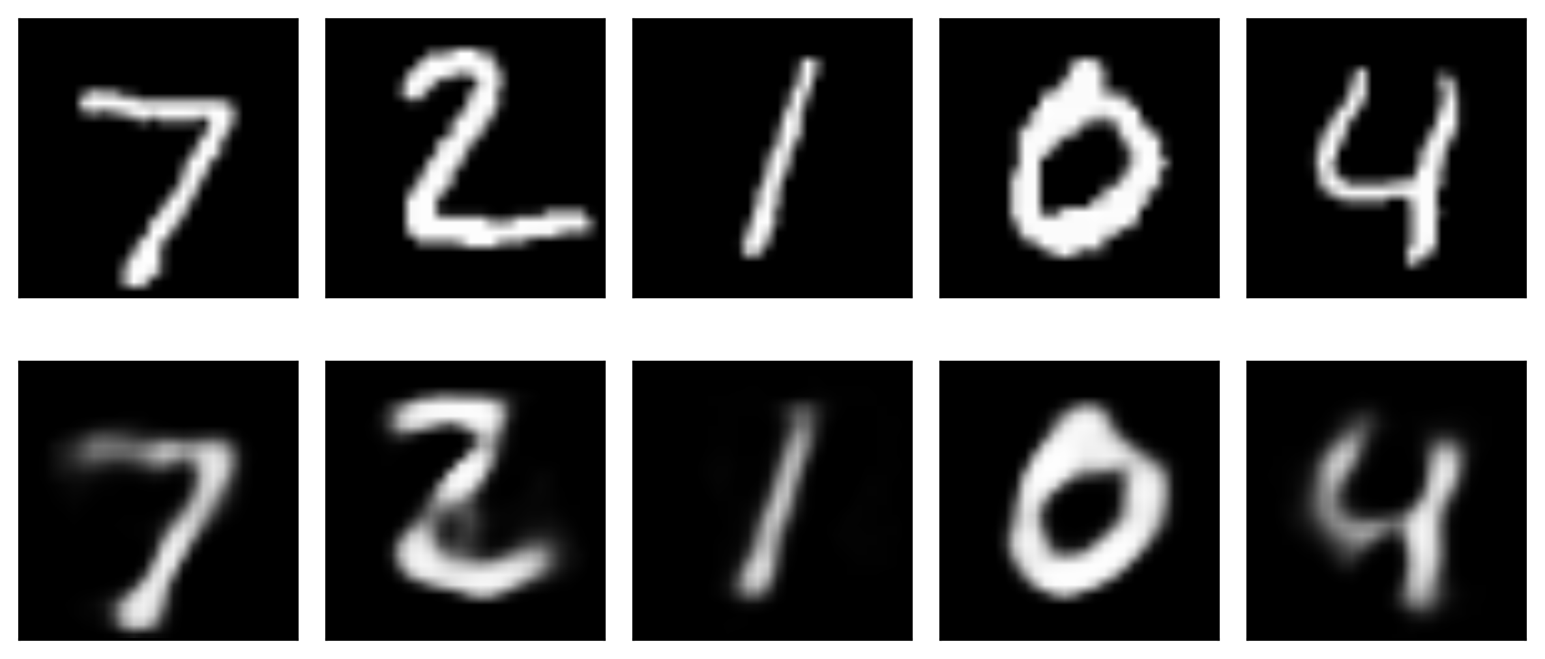
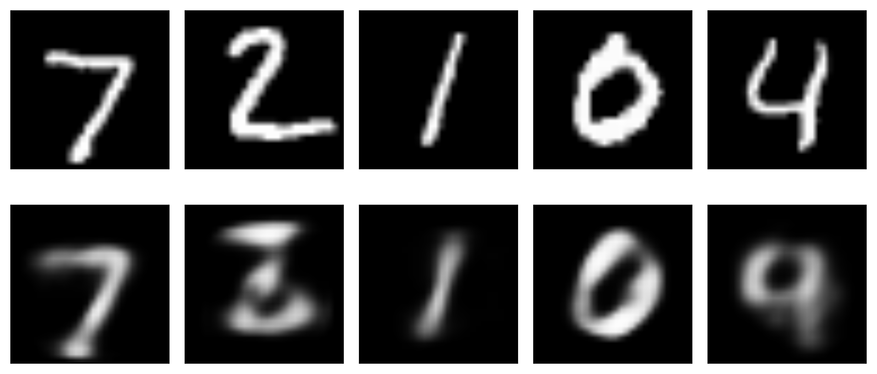
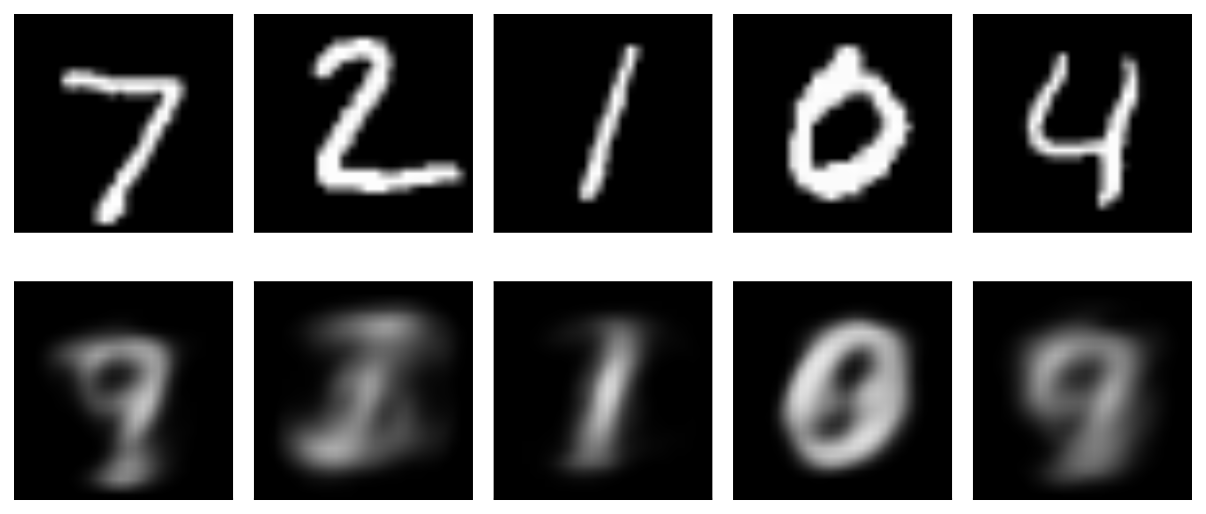
original
20 latent variables
reconstructed
original
10 latent variables
reconstructed
WHY DOES IT WORK?
original
2 latent variables
reconstructed
Image taken from A. Glassner, Deep Learning, Vol. 2: From Basics to Practice
Notes:
The bottom has no changes in a testing set, memorizes

Slide 41
Encoding is easy: Considering a number with infinity number of decimals, we can encode the whole universe.
Learning representation is difficult:
We need sufficient latent dimensions to learn the underlying relationships that are hidden in the data.
WHY DOES IT WORK?
original
2 latent variables
reconstructed
Image taken from A. Glassner, Deep Learning, Vol. 2: From Basics to Practice
Notes:
The bottom has no changes in a testing set, memorizes

Slide 42
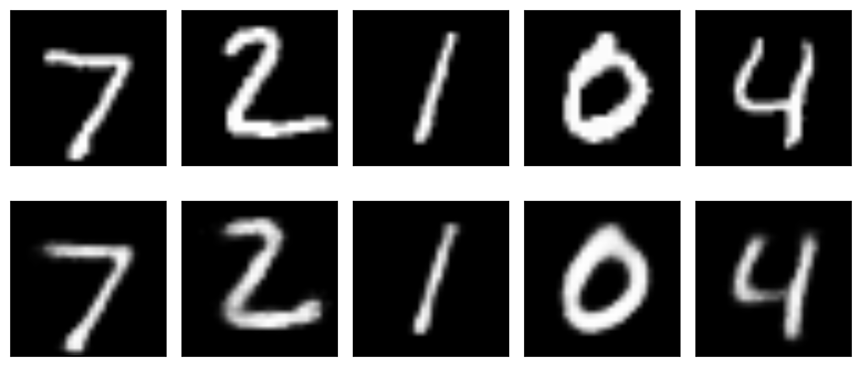
Deeper
For a better representation we can add neurons in one layer or go deeper.
20 neurons
784 neurons
28x28
28x28
Z is 20 dimensional
Original Images
Shallow AE: 20 latent variables
Reconstructed Images

Slide 43
Deeper
For a better representation we can add neurons in one layer or go deeper.
512 neurons
256 neurons
20 neurons
256 neurons
512neurons
784 neurons
28x28
28x28
Z is 20 dimensional
Original Images
Deep AE: 20 latent variables
Reconstructed Images
DEEPER IS BETTER

Slide 44
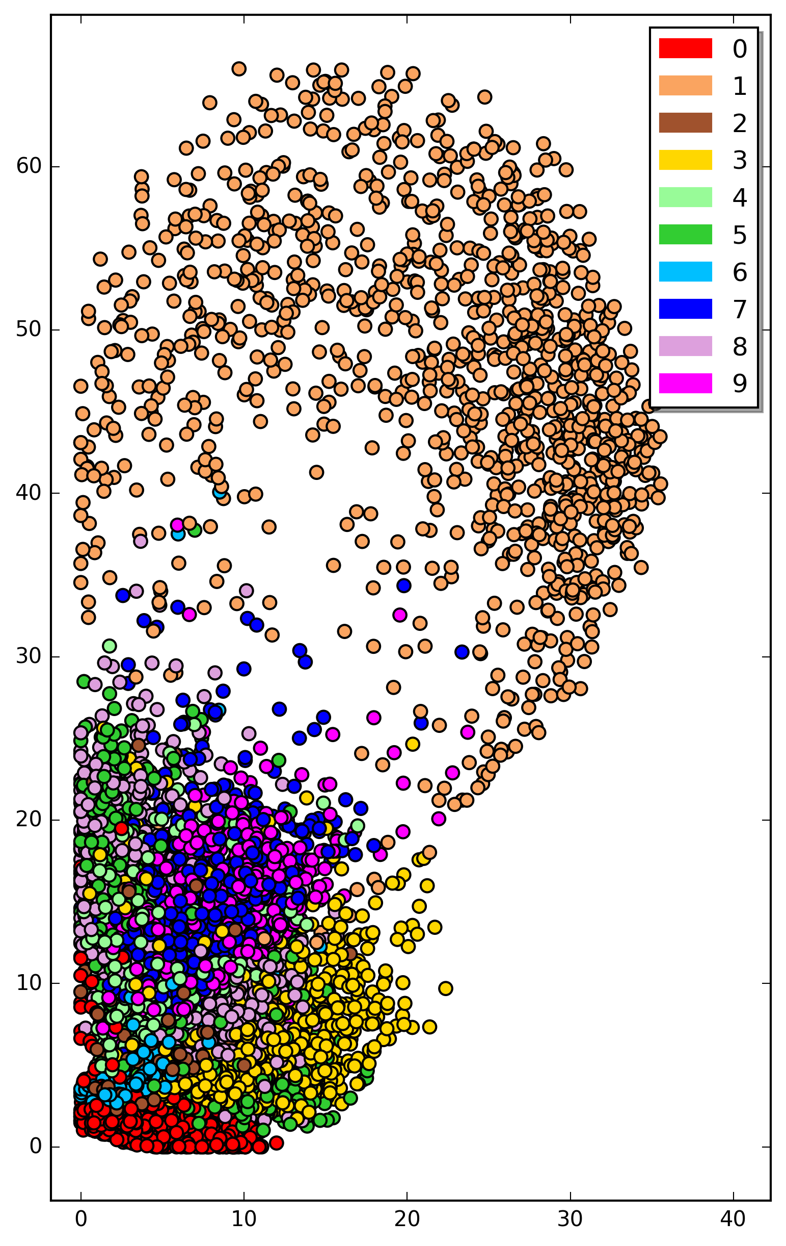
Latent space of autoencoder
If the AE learns the “essence” of the MNIST images, similar images should be close to each other in the Z space, implying Contextual learning
Plot a 2D projection of the latent space to examine the separation (2 PCA components)
Labels (colors) and PCA are used just for visual inspection (evaluation)
Image taken from A. Glassner, Deep Learning, Vol. 2: From Basics to Practice
Notes:
Further examine the latent space. We will come back in this plot when we will talk about blending
(t-SNE for t-distributed Stochastic Neighbor Embedding)

Slide 45
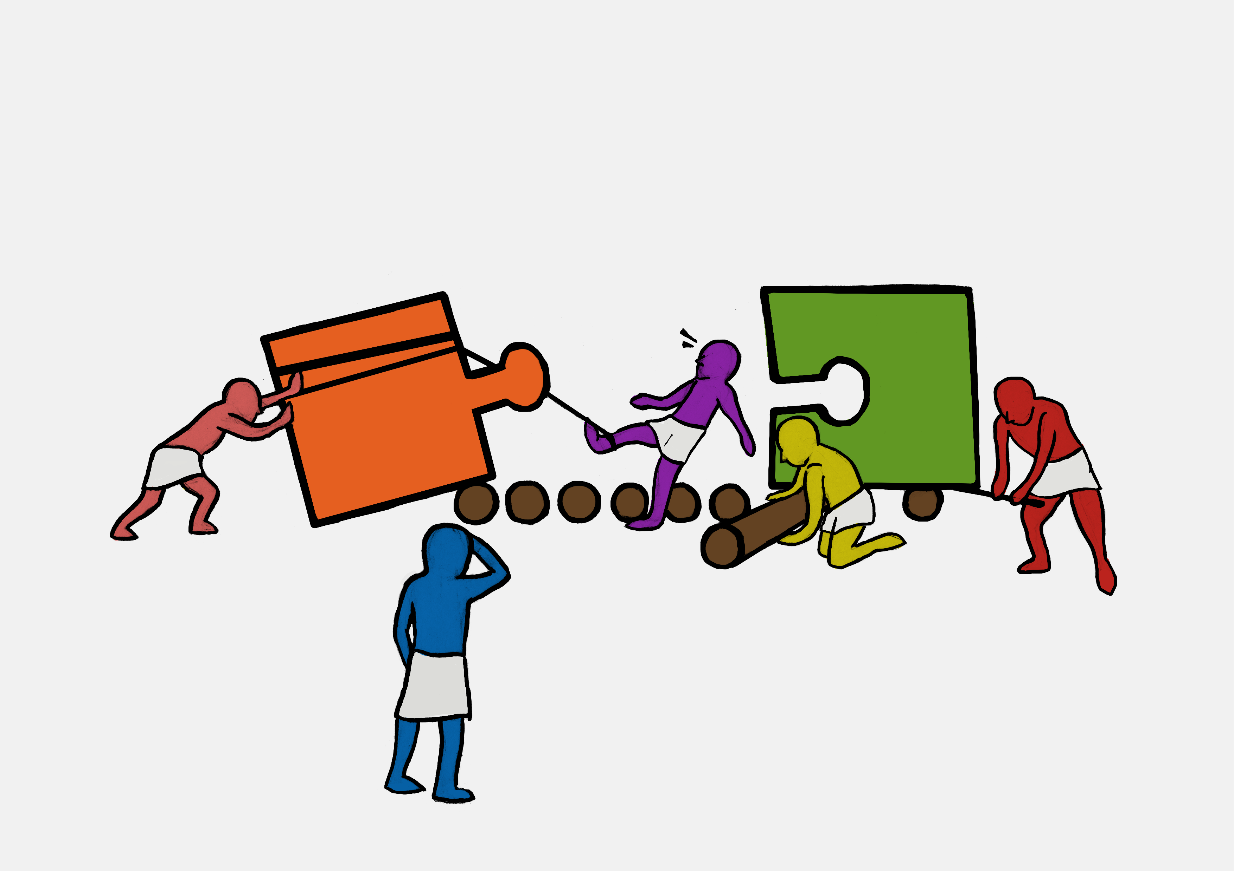
Exercise 1:
Introduction to Autoencoders using the MNIST dataset

